Slide 1

TQFE 2026/27
Katrina MacIntyre
Karen Warner
Susie Wilson
Jane Maylin
August 2026

Slide 2
About the course
This course is delivered online using our virtual learning environment Brightspace.
The work is laid out in sessions with each session lasting for two weeks. The course materials will be available for you on the7th of September when the course starts.
Each session has a range of activities to complete. It is important that you keep up to date with this work and complete the learning activities. These activities do not need to be sent to us but will help you to populate your digital portfolio. One activity per session will be shared during your webinar session and this is highlighted within the learning materials.
There are 1 formative and 2 summative assessments in Semester 1. In Semester 2 there are 2 assessments. The guidelines for these are available under the assignment tile on Brightspace. The submission dates for these are on the module calendar.
Across both Semesters you will populate and create a digital portfolio that evidences the GTCS Standards. The pro-forma for this is available on Brightspace along with the pro-forma that will be used when you are being observed. We will ask you to share your digital portfolio with us for formative feedback throughout the year prior to the final submission in May.

Slide 3

Communication
The TQFE team will communicate with you by email, we will send all the emails to your student email account so it is important that you check this regularly.
We also encourage you to email us if you are finding any of the learning challenging or if you have any questions about it. We can arrange to speak to you face to face or online to support your learning journey.
There will also be Webinars to attend on Teams on a fortnightly basis. These sessions allow you to share your learning and it is an opportunity for you to collaborate with others on the course.

Slide 4
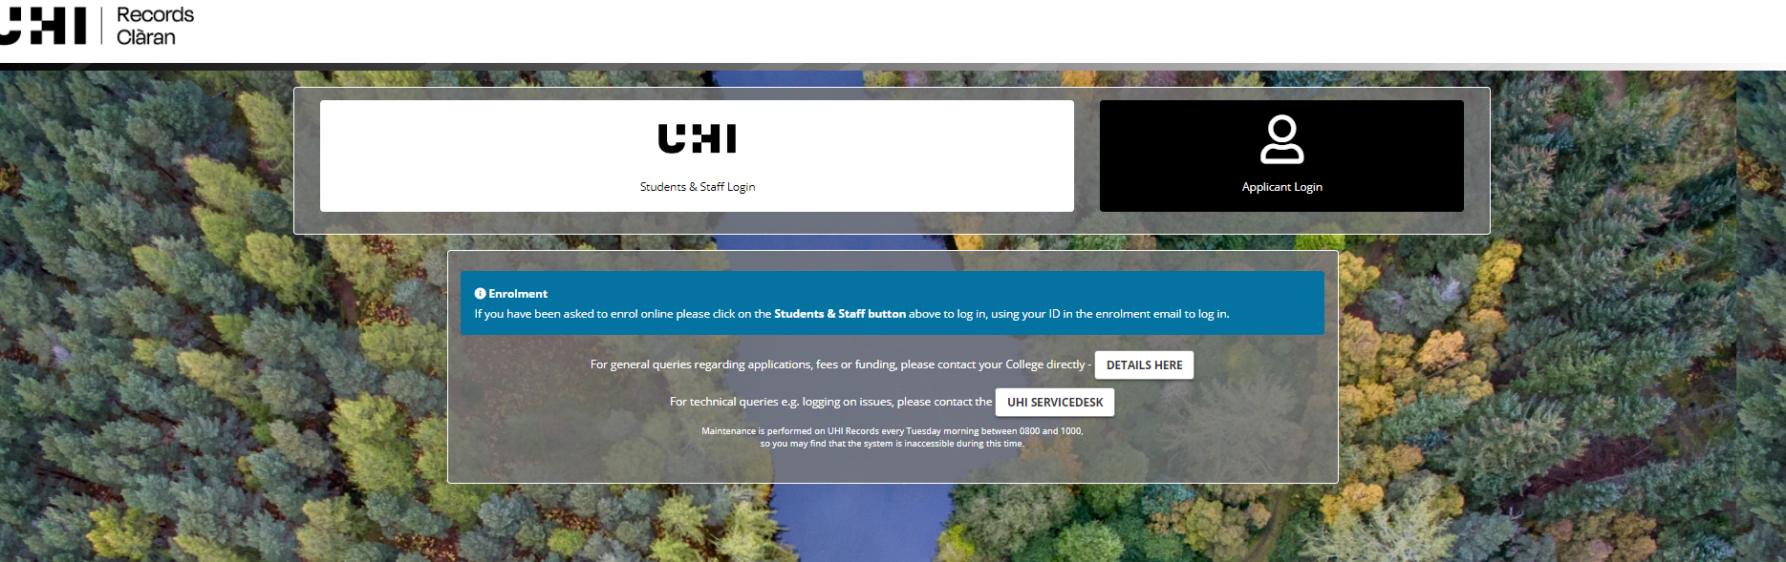
Enrolling online
You should have been sent instructions on enrolling online in your offer or Admissions email. It is really important that you enrol online as soon as possible so that you can begin to access the learning materials and your emails. The following link will take you to the enrolment page: Log in to the portal (uhi.ac.uk)
You will then click on the UHI Students and Staff login, the white section, and enter the ID that was sent in your enrolment email. If you are unsure on how to do this, please email Kat who can help further.
Katrina.macintyre.perth@uhi.ac.uk

Slide 5
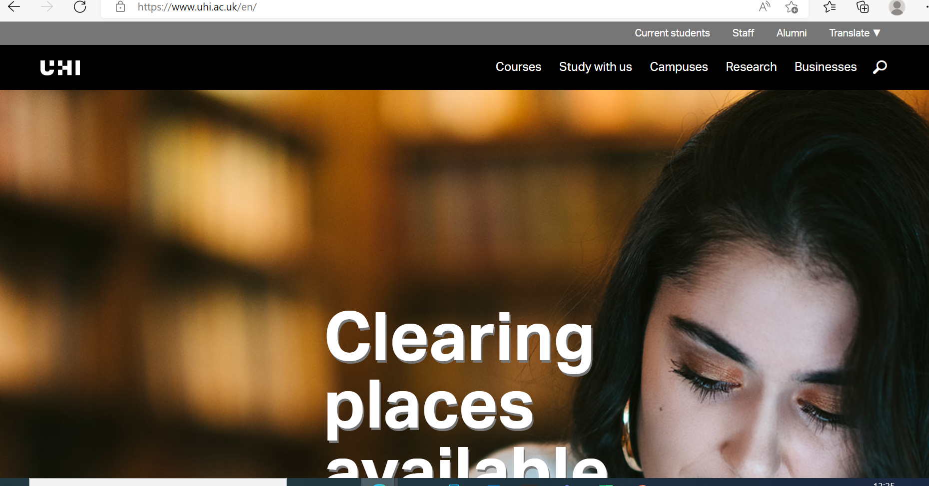
Accessing key resources
To access your email, the virtual learning environment (Brightspace), library resources etc. please go to the main UHI website Home - UHI
Click on the Current Students tab at the top of the page. You should then select the student portal MyDay. This is a one stop shop for all the resources you will need for studying your TQFE. To log into this you need your student ID number@uhi.ac.uk and your e.g. Username: studentID@uhi.ac.uk

Slide 6
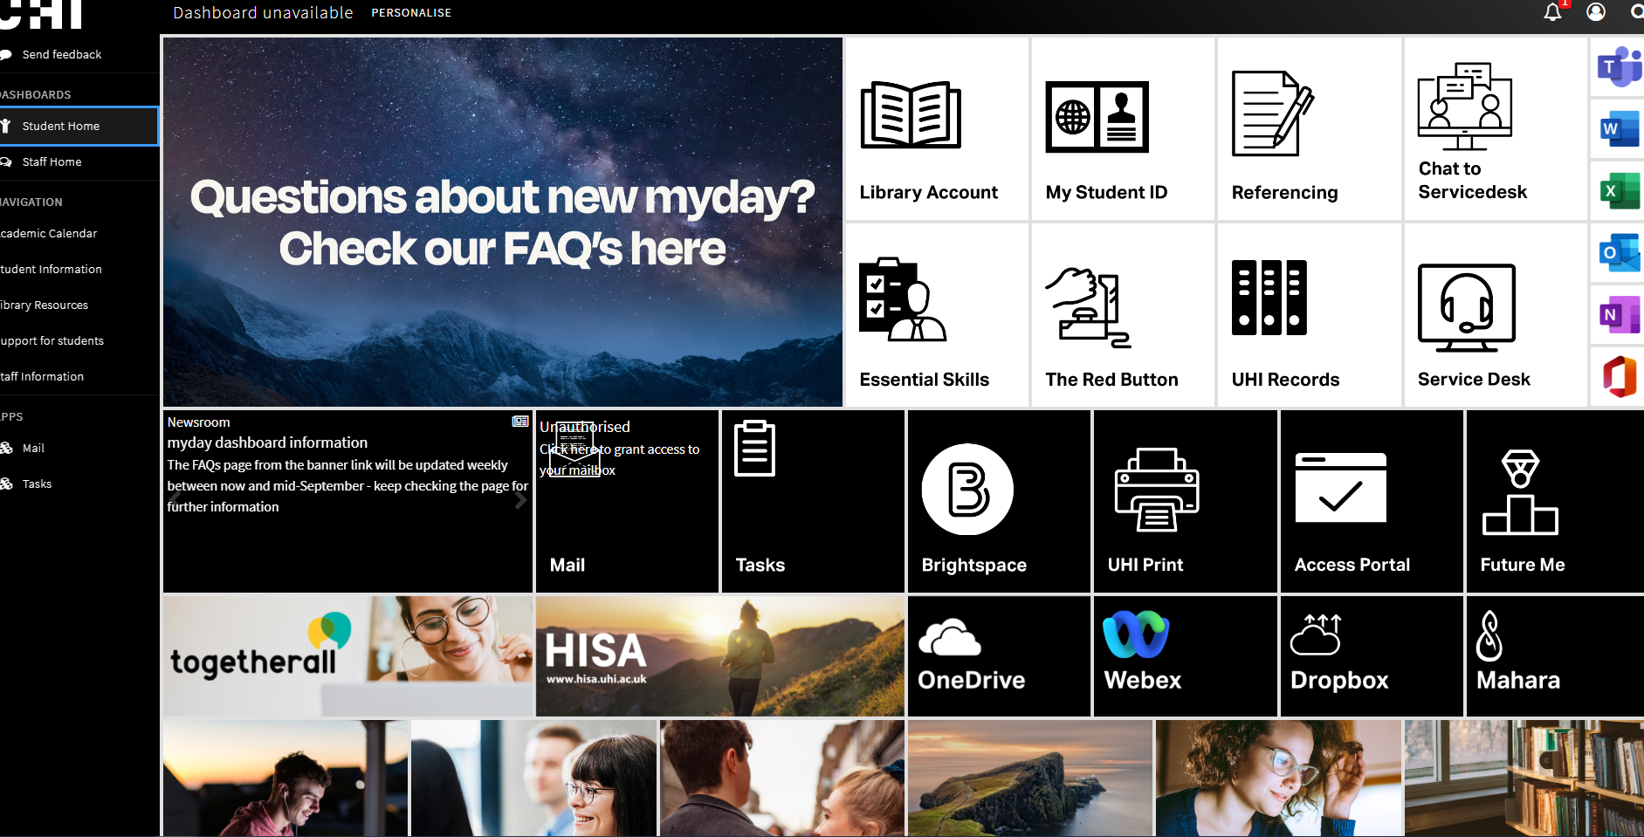
Once you open MY Day and log in you will see the following dashboard which contains tabs/links to the areas you need to access for your student journey.

Slide 7
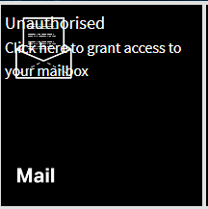
Accessing your Emails
Your college email is the way in which we will communicate with you so please make sure that you check this regularly.
To access this:
Click on the email tile on MyDay
Or you can access it using this link:
https://www.outlook.com/uhi.ac.uk/
Your username is: studentnumber@uhi.ac.uk
Your Password

Slide 8

Brightspace Virtual Learning Environment
Brightspace is the learning space where all of the materials you need to be successful in your learning are.
To access this:
Click on the Brightspace tile on MyDay
Or you can access it using this link:
https://brightspace.uhi.ac.uk/

Slide 9
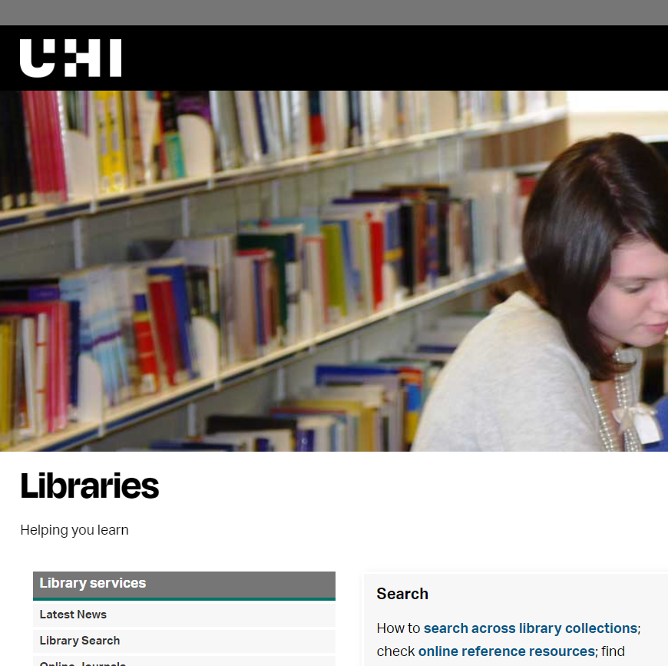
UHI Library
The library home page has a range of resources to support you with your studies.
The reading list for the course can be found at: Teaching qualification further education (PGCert) - Lists - Talis Aspire Reading Lists

Slide 10
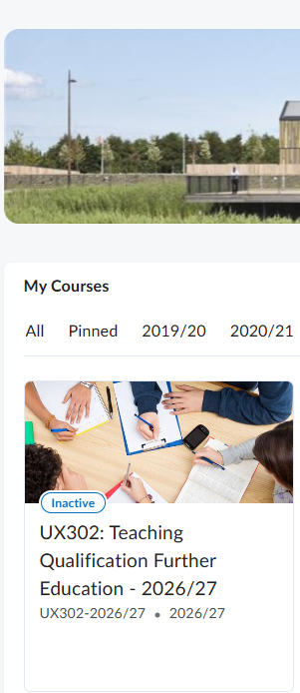
Brightspace continued
To log into Brightspace your username will be your student number and your password.
You will then see a page similar to this. You will have one learning tile called UX302 Teaching Qualification Further Education. If you can not see this when you log in, please get in touch with Kat.

Slide 11
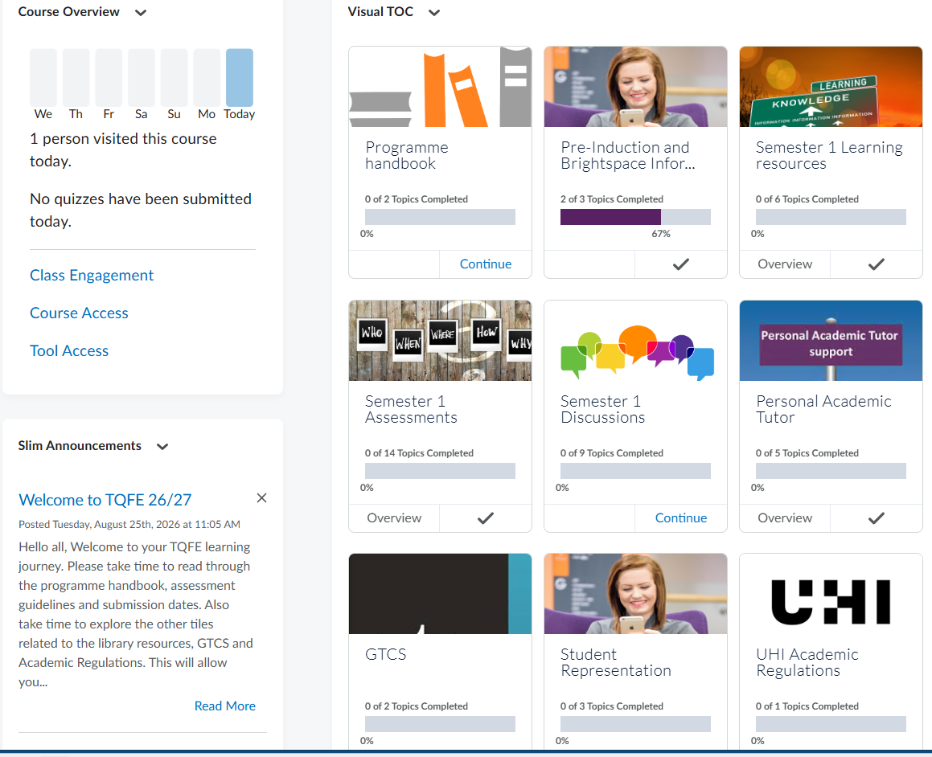

Learning Resources
Once you click on the TQFE tile you will be taken to the learning space which contains all the materials for this years learning.
Your first task is to have a play about and get used to the system and leave a message for us on the discussions.

Slide 12
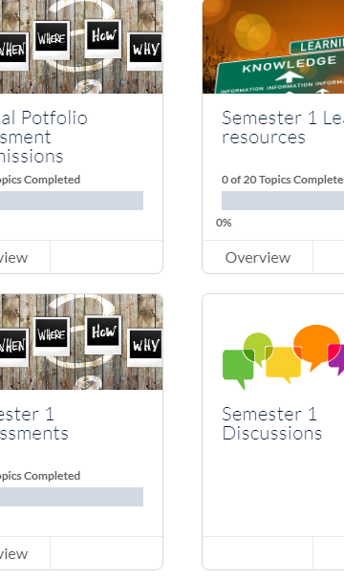
Online Learning Resources
Take time to explore the information tiles related to GTCS, UHI and Academic Skills
You can then select the Semester 1 learning resources tab and begin your learning.
Select the Semester 1 Assessment tile and take a look at the assessment guidelines.
Finally, please introduce yourself on the welcome discussions which you will find by clicking on the Semester 1 discussions tile.

Slide 13

Webinar Session
You will be able to access your webinar sessions through Teams.
Your session will run in week two of the session. The first session will be week commencing the 14th of September.
Once you have selected your preferred session this will remain on the same day and time for the duration of your studies.
You will be sent out a form asking you to make a first and second choice for your preferred webinar session. Once complete you will be allocated to a group.
There are 6 webinar sessions per semester.

Slide 14
Key Dates: Semester 1
Semester 1 begins on Monday 7th of September
First Webinar session is w/c the 14th of September.
There is no teaching or new learning during weeks 12/10 and 19/10 to allow all staff to enjoy your holidays.
Semester 1 ends on Friday 14^{h} of December

Slide 15

Key Dates: Semester 2
Semester 2 begins on Monday 25th of January
First Webinar session is w/c the 1st of February.
There is no teaching or new learning during weeks 29th March and 5th of April to allow all staff to enjoy your holidays.
The course ends on Friday the 3rd of May 2027.

Slide 16

Any Questions
Remember to check your emails as we will be sending this guide out to you and we would like you to email us back to let us know that you can access your emails.
We are always available to answer questions or offer further support so please get in touch if you have questions.

